Slide 1

CLAIMS TRAINING
Timely Claim Handling
for Parish & School Managers
How to move claims forward efficiently
and protect your parish’s financial recovery
Presented by: Andrea Penka and Richard Medina, Catholic Mutual Group
01

Slide 2
WHY TIMELINESS MATTERS
02
Speed protects both property and recovery
TIMELINESS
IS FINANCIAL
01
Faster stabilization of damage
02
Reduced disruption to parish operations
It is not merely an administrative task. It directly affects how much reimbursement the parish can receive.
03
Prevention of secondary damage
04
Full eligibility for Replacement Cost benefits
ACT EARLY

Slide 3
IMMEDIATE ACTIONS AFTER A LOSS
03
The first hour sets the claim in motion
01
Report promptly
02
Protect the property
Call or email as soon as damage is discovered. Early reporting means faster inspection, faster payment, and fewer complications.
Stop ongoing damage: shut off water, arrange temporary board-up, and take other reasonable protective steps.
PRESERVE THE RECORD
Document conditions with photos and video.
REPORT → PROTECT → DOCUMENT

Slide 4
READINESS
04
Your emergency vendor list should exist before the loss
READY
01
04
Water mitigation
Plumbing
Dry-out & moisture response
Stop & repair active leaks
Pre-identify contractors who can respond when buildings and operations are under pressure.
02
05
Roofing
General contracting
Temporary & permanent work
Coordinate the full scope
03
06
Electrical
Specialty trades
Restore systems safely
Stained glass • historic masonry
“Don’t wait until the emergency to figure out who you’ll call.”

Slide 5
RISK MANAGEMENT • VETTING VENDORS
05
Five checks turn a vendor list into a risk-control tool
1
Verify insurance
Current general liability, workers’ compensation, and auto coverage
2
Confirm credentials
Licensing and relevant certifications
3
Check performance
References, parish experience, and response times
4
Control demolition
No demolition without approval
5
Require evidence
Moisture logs, scope justification, and supporting records
RISK MANAGEMENT CONTENT CHECKPOINT

Slide 6
WHAT HAPPENS AFTER YOU REPORT
06
Every claim moves through six progress points
01
02
03
04
05
06
Claim Reported
Inspect
Get bids
Compare and Select Contractor
Pay ACV
Recoverable Depreciation
Initial contact + Independent adjuster
Damage + baseline
1–2 contractor bids
Bids vs. IA estimate
Based on accepted amount
Complete repairs timely and collect RCV
The accepted bid must align with the independent adjuster’s scope.
“A clear scope and timely bids keep the payment decision moving.”

Slide 7
UNDERSTANDING ACV VS. REPLACEMENT COST
07
ACV pays first; recoverable depreciation follows the work
PAID UPFRONT
PAID AFTER REPAIRS
ACV
RC
Actual Cash Value
Recoverable Depreciation
Depreciated value
Paid once the estimate/ bid is finalized
Requires invoices and proof of completion
Repairs must be completed within 1 year of loss
ESTIMATE → REPAIR → DOCUMENT

Slide 8
THE 1-YEAR REPAIR REQUIREMENT
08
The 365-day clock starts on the date of loss
365
Complete repairs within one year to receive recoverable depreciation.
01
DAYS
If repairs are incomplete
Reimbursement is limited to ACV; recoverable depreciation is forfeited.
02
If circumstances are exceptional
Submit a written extension request. If granted, RC may still be limited to the original estimate.
“The extension protects the timeline, but not cost overruns.”
Confirm requirements against the applicable policy and claims guidance.

Slide 9
WHY TIMELINES STALL
09
Claims stall at six predictable handoffs
01
Delayed reporting
02
Slow bid collection
03
Contractor availability
04
Scope or Cause disagreements
05
Weather delays
06
Decision bottlenecks
MOST DELAYS ARE PREVENTABLE WITH EARLY ACTION.

Slide 10
WHEN WE NEED AN EXPERT OPINION
10
When facts are disputed, engineering closes the gap
01
02
03
Unclear or disputed
Licensed engineer
Final determination
IA findings need resolution
Analyzes cause and extent
Findings guide the claim

Slide 11
ADDITIONAL COVERAGES YOU MAY USE
11
Additional coverages can keep ministry operating
Extra Expense
Debris Removal
Temporary relocation, rental space, emergency equipment
Removal and disposal after a covered loss
Priests’ Personal Property
Emergency Mitigation
Clothing, books, and personal items damaged in a covered event
Immediate measures that limit further damage
Ordinance & Law
Required upgrades to meet current building codes
“These coverages help keep ministry operations running.”

Slide 12
COMMON COVERAGE LIMITATIONS & EXCLUSIONS
12
Four common conditions can limit coverage
4
01
Wear and tear
Normal aging and use over time
02
Maintenance-related issues
COMMON
CONDITIONS
Damage tied to routine upkeep or deferred maintenance
03
Deterioration / Rot
Coverage depends on the cause of loss and the applicable certificate terms.
Progressive decay, including wet and dry rot
04
Long-term leakage
Seepage or leakage occurring over an extended period

Slide 13
DOCUMENTATION ESSENTIALS
13
Complete documentation accelerates every stage
01
02
03
Photos / video
Contractor bids
Moisture logs
Document the conditions
Define proposed work
Support water-loss decisions
04
05
06
Invoices + payment
Parish contacts
Content Inventory
Document completed costs
Keep decisions moving
Document content damage and replacement cost
“Good documentation speeds up every stage of the claim.”

Slide 14
COMMON PITFALLS
14
Avoid five expensive detours
×
Starting repairs before the IA inspection
×
Allowing mitigation vendors to demo without approval
×
Accepting scopes that exceed the IA estimate
×
Missing the extension request when delays occur
×
Failing to communicate changes in scope or cost
PAUSE • APPROVE • PROCEED

Slide 15
HOW YOU CAN KEEP CLAIMS MOVING
15
Business managers are the claim’s momentum owners
KEEP IT
MOVING
Report
Maintain
immediately
the vetted vendor list
Obtain
Communicate
Your role is to shorten every handoff.
bids quickly
delays early
Track
Submit
repair progress
invoices promptly

Slide 16
QUICK REFERENCE • 1-YEAR RULE
16
One year determines the recovery path
01
Repairs completed within 1 year
→
FULL RC ELIGIBILITY
02
Repairs not completed
→
ACV ONLY
03
Extension requested in writing
→
TIMELINE EXTENDED • RC CAPPED AT ORIGINAL ESTIMATE
Confirm requirements against the applicable policy and claims guidance.

Slide 17
17
Q&A
Questions shape better
response plans.
DISCUSSION

Slide 18
Timely action protects
your parish, your operations,
and your financial recovery.
REPORT EARLY • DOCUMENT WELL • KEEP MOVING
Andrea Penka | Property Claim Manager
Catholic Mutual Group
W | (402)514-2442
C | (402)618-8032
apenka@catholicmutual.org
19

Slide 19

Diocese of Des Moines
Business Managers Meeting
Risk Management

Slide 20
Your CMG Risk Management Contact
Dustin Heino| Claims Risk Manager
Catholic Mutual Group | 10843 Old Mill Road Omaha, NE 68154
W | (402) 514-2481
C | (712) 790-2872
F | (402) 551-2943
dheino@catholicmutual.org
DeAnn Bianchette| Risk Control Manager
Catholic Mutual Group | 10843 Old Mill Road Omaha, NE 68154-2600
W | (402) 514-2317
C | (402) 850-1163
F | (402) 551-2943
dbianchette@catholicmutual.org

Slide 21
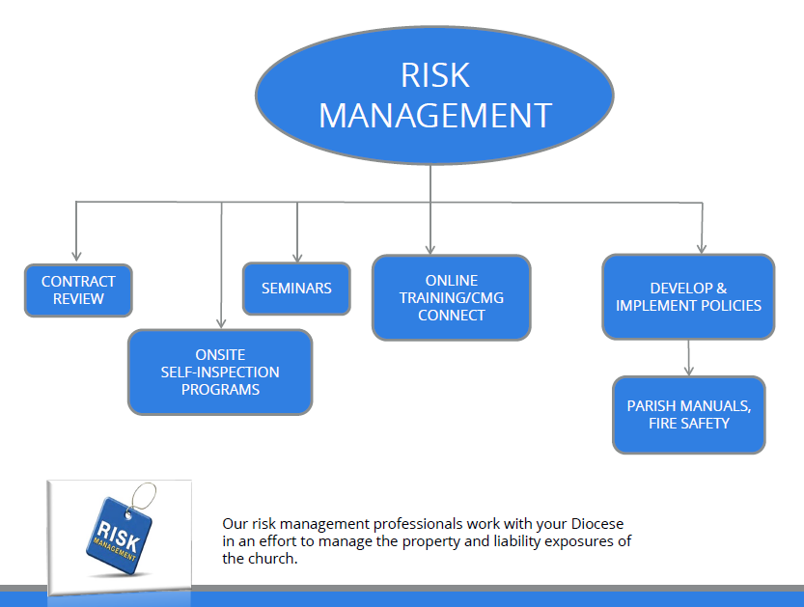

Slide 22
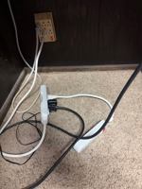
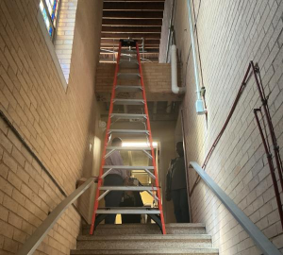

Inspections

Slide 23
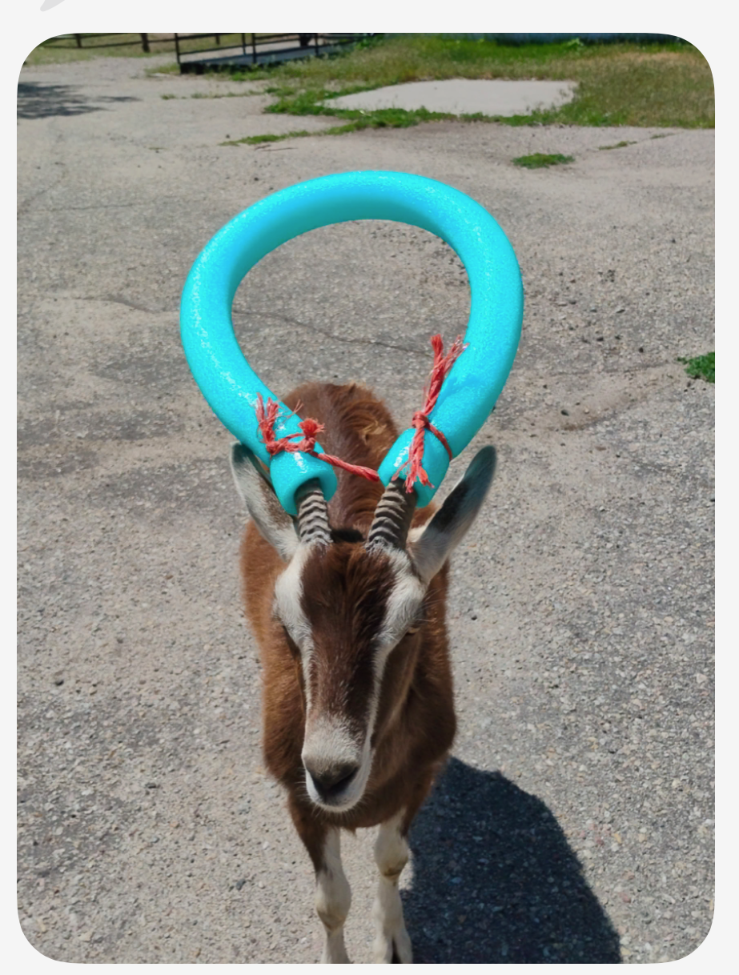
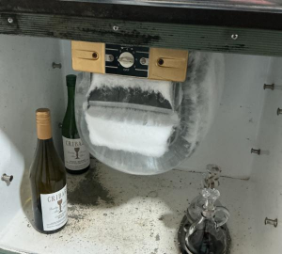
Inspections

Slide 24
Common Slip, Trip & Fall Hazards
  Uneven or cracked sidewalks/parking lots
  Ice, snow, rain not dealt with at entrances, steps, ramps, and high foot traffic areas
  Worn, loose, or curled rugs/mats
  Poor lighting
  Cluttered walkways
  Missing or unsecure handrails

Slide 25
Preventing Slip, Trip & Falls
  Seasonal weather planning
    Establish snow and ice removal plans and log removal activities
    Ensure adequate supply of salt/sand and floor mats
  Preventative maintenance
    Promptly repair known cracks, uneven surfaces, and broken handrails
    Keep exits, walkways, and aisles clear of cords, boxes, and stored items
  Improve Visibility
    Mark changes in elevation, steps, or uneven surfaces with yellow paint
  Regular inspections
    Routinely check high-traffic areas such as entrances,
    stairways, parish hall, especially before Masses and events

Slide 26
Transportation
Acceptable Driver Qualifications
  Must be 21 years of age or older, unless transporting individuals
  Valid driver’s license and satisfactory driving record
  Current registration and license plates
  Personal Insurance Coverage (100,000 per person / 300,000 per occurrence)
  Volunteer Drivers Form should be completed by ALL volunteer drivers
  Drivers must have a current MVR to ensure record is satisfactory.

Slide 27
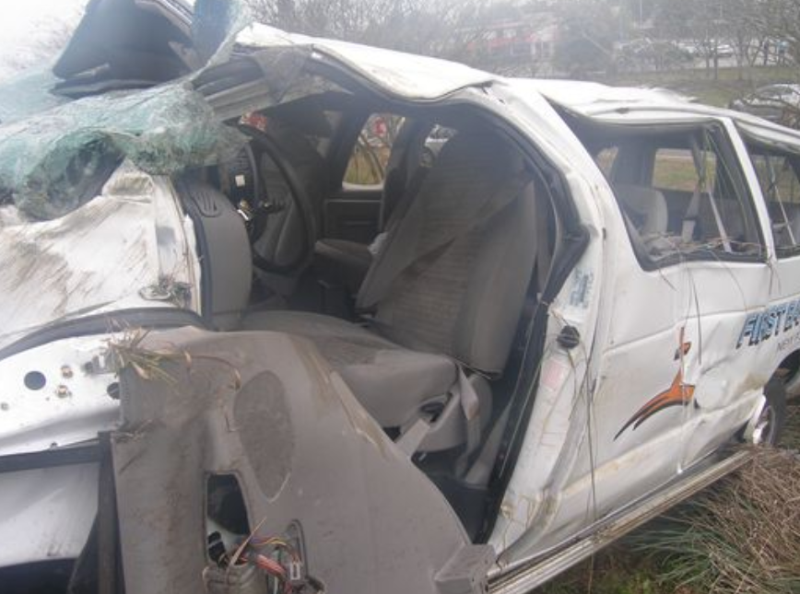
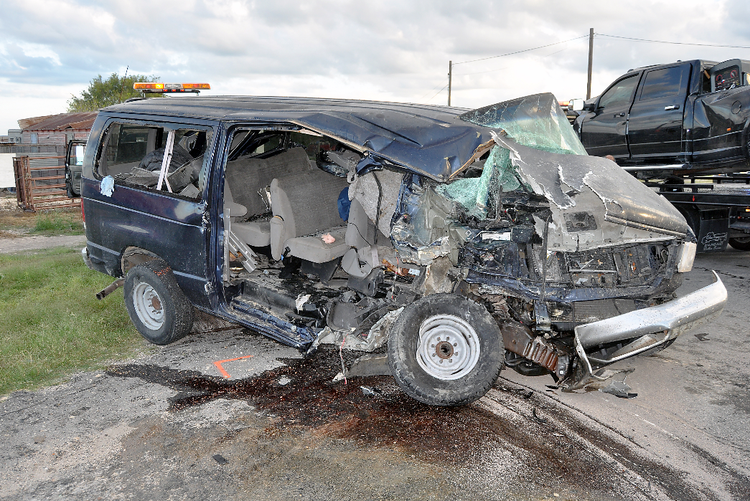
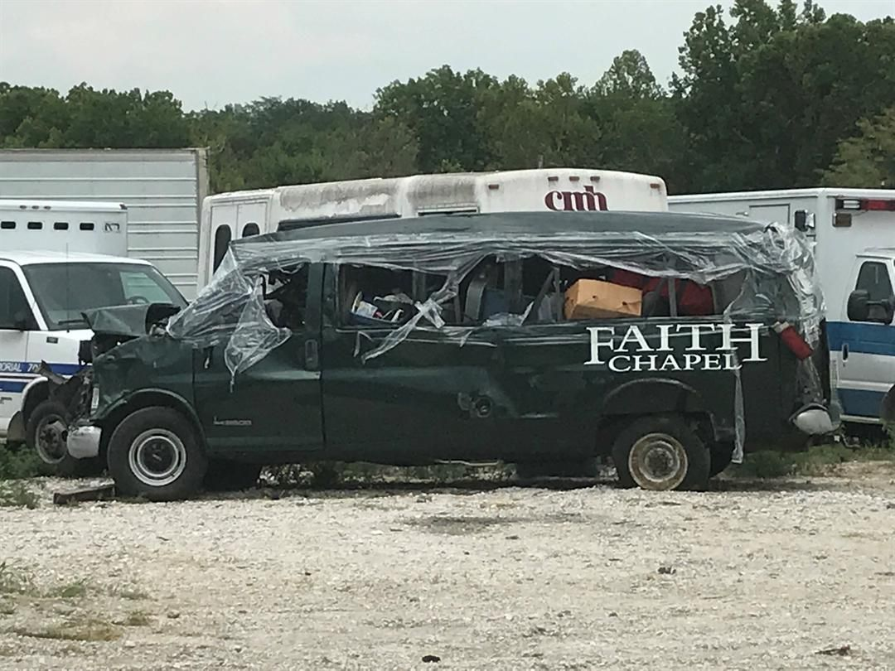
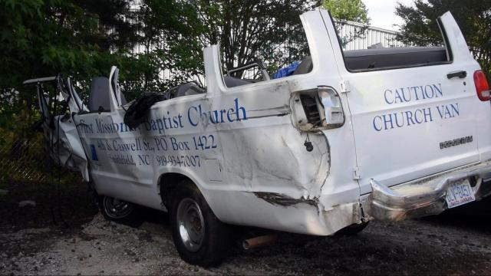
Notes:
When I first started handling serious vehicle accident claims, my first accident invoving a fatality was a youth group traveling to an event in an 11-15 passenger van. The driver of the van was one of the youth and she died of crush asphyxiation. The other front seat passenger was paralyzed. The girls were so badly injured, they were originally misidentified. The remaining passengers sustained less severe injuries but were scarred by watching their friend pass away.

Slide 28
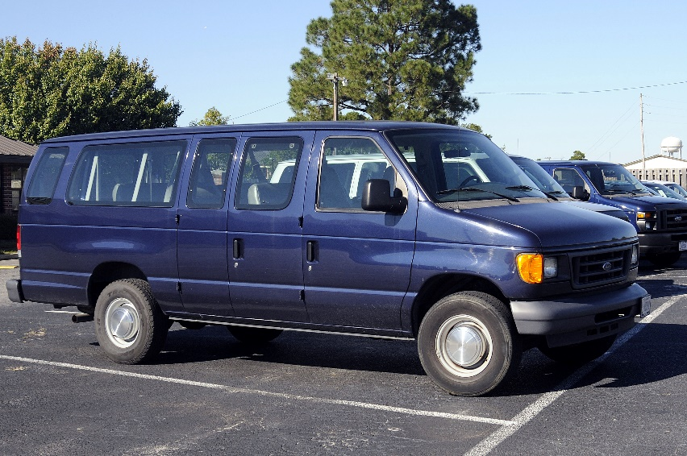
11-15 Passenger Vans Prohibited
Problems
Dangerous for transportation
Originally designed for cargo transportation
NHTSA Safety Act prohibits a school from buying or leasing
- Unless meet FMVSS school bus standards
- Severe injuries in side-impact accidents
New study by NHTSA shows these vans 3 times more likely to roll over when carrying 10 or more passengers
Solutions
Replace with mini-school bus/ multi function activity bus
Replace with 2 mini-vans

Slide 29
Why is Contract review important?
To ensure that unnecessary liability and financial risk is not being taken on by the parish or Diocese under the contract
To transfer risk and financial responsibility to the proper party and protect diocesan entities from potential claims
RM goal – minimize the impact of a potential exposure or prevent something bad from happening
These practices promote accountability and responsible management to safeguard parish and diocesan assets.
Before entering into an agreement with a third-party contractor, service vendor, tenant or facility user, it is important that the contract or agreement be referred to the diocese and/or Dustin Heino with Catholic Mutual Group for review of insurance requirements and any adverse indemnification language.

Slide 30
Examples of when contract review is recommended
  Larger Construction Projects, Building Remodeling or Renovations to Parish property
  Small Contractor Jobs and Service Vendors performing work and/or services on Parish Property
  When Parish Facilities are Being Used for Non-Parish Sponsored Events on a Short-Term Basis
  When Parish Property is Leased on a Long-Term Basis
  When individuals or small groups use parish facilities and have no insurance.
  When using non-parish property for parish sponsored activity.

Slide 31
Beyond Construction – Broader Contract Awareness
Contract review is not limited to construction or high-risk activities
Reviewing vendor, rental, and service agreements is also vital to manage everyday operational risks effectively
A broad approach to contract awareness helps diocesan entities identify risks and avoid overlooked agreements
To ensure that that Catholic Mutual has adequate time to review a contract, please allow at least ten (10) business days for review

Slide 32
Within our scope:
Construction or renovation projects
Facility Use – use of parish/school/diocesan facilities
Leases
Parish festivals and similar events – vendor hold harmless indemnity agreements
Onsite service agreements (maintenance services or small construction projects)
Offsite facility use for a parish sponsored event
Independent Contractor Agreements
Catholic Charities/social services
Collaboration Agreements or MOU/MOA
Security Contracts

Slide 33
Beyond our scope:
Software and licensing agreements
Purchase orders or sales agreements
Real estate transfers
Financial institutions/bank contracts/transactions
Fleet Service Agreements (or offsite service agreements)

Slide 34
CMG addendums/sample contracts
  Addendum to Construction Contract
  Addendum to Construction Contract (When contractor provides Builder’s Risk Coverage)
  AIA Documents (needed deletions)
  Addendum to Service Contract
  Facility Usage/Indemnity Agreement
  Addendum to Lease
  Adult Hold Harmless/Indemnity Agreement
  Addendum to Contract (CMG’s Coverage & Indemnification Guidelines)
  Vendor Hold Harmless/Indemnity Agreement

Slide 35
Benefits to Using Our Addendums
They already address our insurance and indemnification concerns in contracts
They save time by assisting our membership in neutralizing unfavorable insurance language.

Slide 36
Certificate of Insurance (COI)
What is a COI?
  A certificate of insurance (COI) is a document that provides proof of insurance and summarizes the key details of an insurance policy, such as the types of coverage, policy limits, and effective dates.
  It is used to prove that the party you have hired has the required insurance coverage for a contract, project, or transaction necessary to protect all parties involved from financial risk.
  A COI is not an insurance policy rather it is a summary of the type of insurance coverage available.

Slide 37
Additional Insured Status
The insurance certificate furnished to the parish by a contract partner must indicate in writing that both your parish and the Diocese of Des Moines are named as an additional insured.
It is not adequate to obtain a certificate of insurance from a contract partner which names the parish and Diocese as a “certificate holder.” The insurance policy must be endorsed and certificate reflect the Additional Insured endorsement.
When named as Additional Insured, the 3rd party policy must provide the defense.
Since a contract partner will have to make a specific request to their insurance company to get the parish named as an additional insured, it is important to inform them of this requirement well in advance.

Slide 38
Available Training Resources
  Risk Management “CARES”
  Best Practice Resource Library
  Transportation
  Be Smart – Drive Safe II
  Church Transportation – Is it Necessary and Ministry Based?
  Completely Avoidable Tragedy
  Youth Ministry
  Youth Ministry – Everything Matters and Everyone Has a Role
  Safe Environment
  Safe Haven – It’s Up to You (3-part training program)
  A Safe Haven Starts at Home
  A Safe Side of the Line
  Safe Haven: Religious Education
  Vulnerable Adults eLearning
  Protecting Vulnerable Adults
  Keeping Student Athletes Safe: Creating Emotional Security & A Secure Environment NEW!
  CMG CARES for Kids Newsletters
  Parish Festivals
  Safe and Successful Parish Festivals
  Cyber Safety & Liability
  Malware and Phishing eLearning
  Church Cyber Awareness Series (presented by Tokio Marine)
  Cyber Awareness Series from Tokio Marine
  Phishing
  Ransomware
  Employee Mistakes
  Intro to Data Breaches
  Wire Fraud
  Business Email Compromise
  Safety
  Fire Safety
  Preventing Slips, Trips & Falls
  Preventative Maintenance
  Taking Care. Saving Lives. (AED training)
  Pastoral Administration
  Best Practices for Financial Management & Cash Handling
  Best Practices in HR Management
  Best Practices for Facilities Usage & Management
  Sexual Harassment and the Church
  Clergy Training: The Highest Standard
  Incredible But True: Yes, That Really Happened
  Critical Incidents: Preparation & Response
  Modern Money: Accepting Electronic Payments NEW!
  School Safety
  Defeating a Violent Intruder
  Getting Ready to Defeat a Violent Intruder
  Bloodborne Pathogen Training
  Playground Safety
  Youth Camp Safety eLearning
  School Top Safety Hazards eLearning
  Anti-Bullying Training Series
  Preventing Youth Suicide
  Fair, Kind & Free
  Keeping Student Athletes Safe: Preventing Accidents & Injuries video NEW!

Slide 39
Claims
Speaker box fell on an organ causing damage.
Fire sprinkler suppression system

Slide 40
Travelers BoilerRE
CMG has partnership and they will be able to inspect boilers nationwide.
To schedule:
Call 800.425.4119 or email boilinsp@travelers.com with the following information
  Location Name/Policy Number, if available
  Location address
  Contact information for scheduling
  Jurisdictional Object number(s) & Cert Expiration Date(s), if available
  Requested inspection time (e.g. weekday morning before 8 AM)
Peyton Edwards is our CMG contact
Pedwards@catholicmutual.org

Slide 41

Q&A

Slide 42
Andrea Penka – Property Claim Manager
Scott Oligmueller – Loss Control Representative

